Slide 1
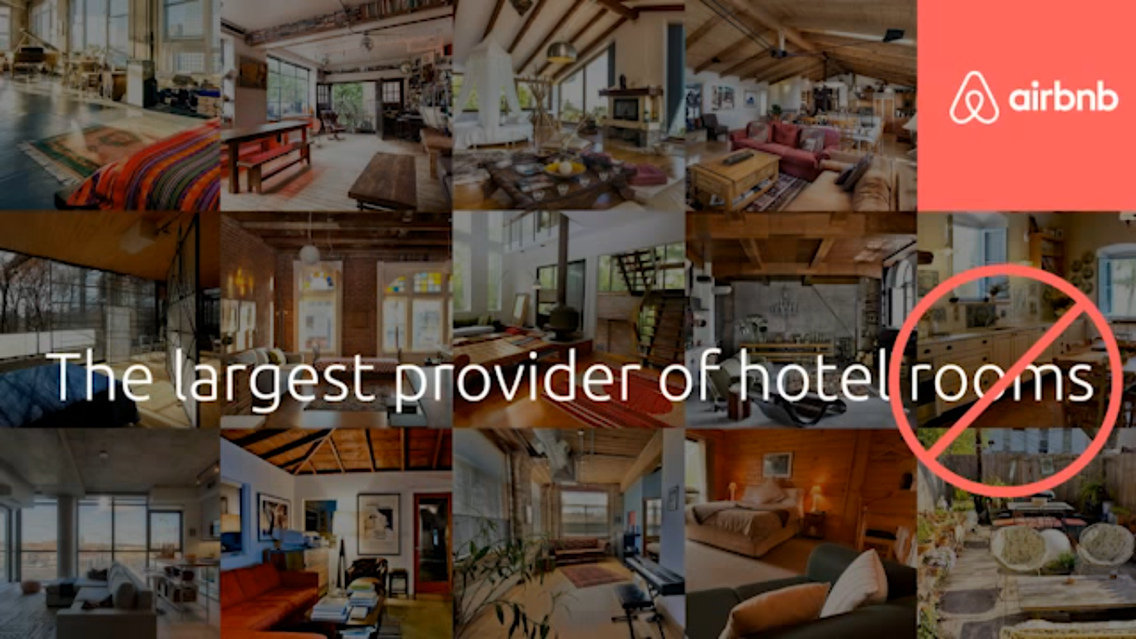

Slide 2

Airbnb is a peer-to-peer online marketplace and homestay network enabling people to list or rent short-term lodging in residential properties, with the cost of such accommodation set by the property owner. The company receives percentage service fees from both guests and hosts in conjunction with every booking.^{[1]} It has over 2,000,000 listings in 34,000 cities and 191 countries.^{[2][3][4]}Airbnb was founded in August 2008, is headquartered in San Francisco, California, and is privately owned and operated.

Slide 3
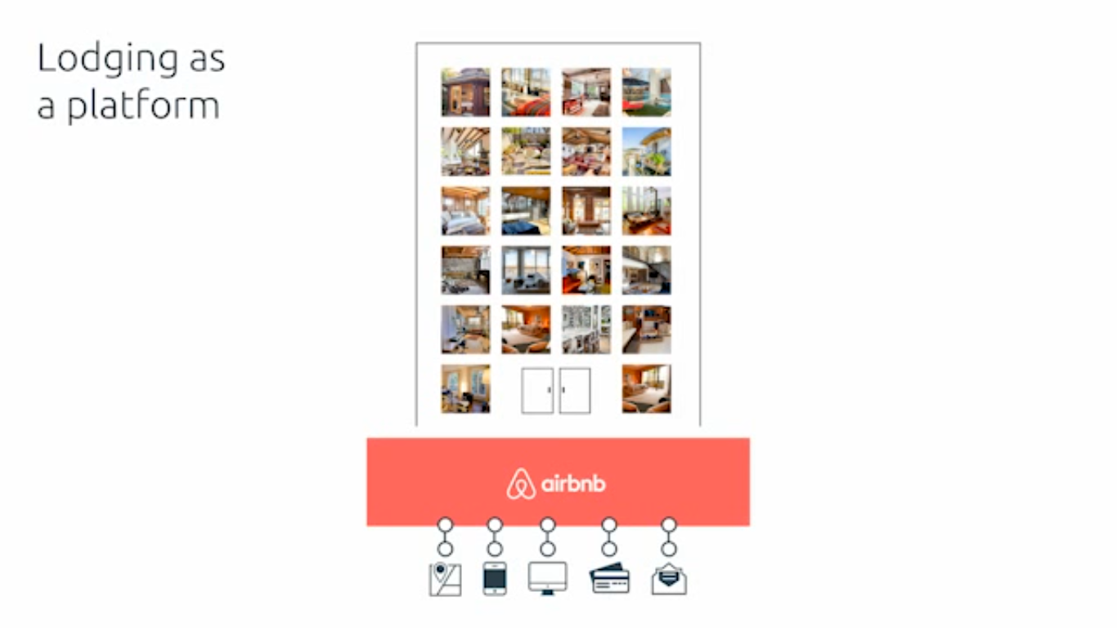

Slide 4
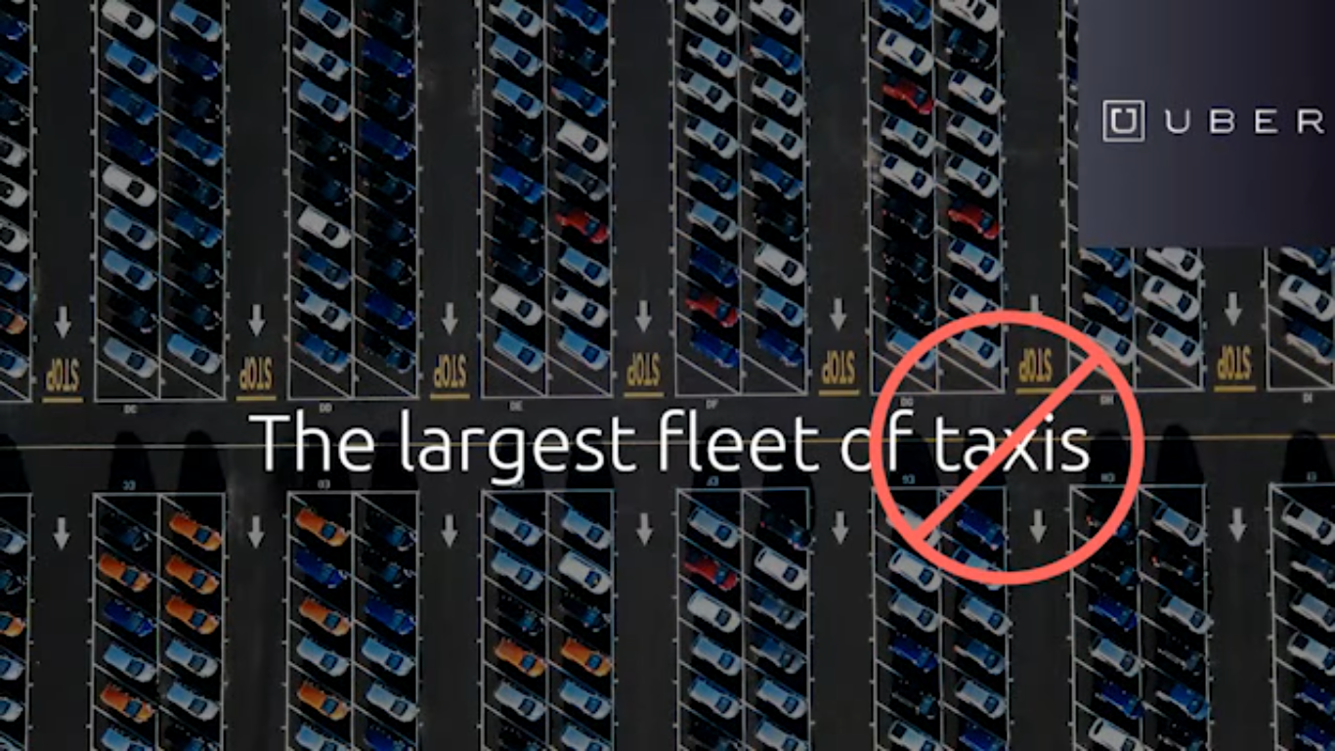

Slide 5
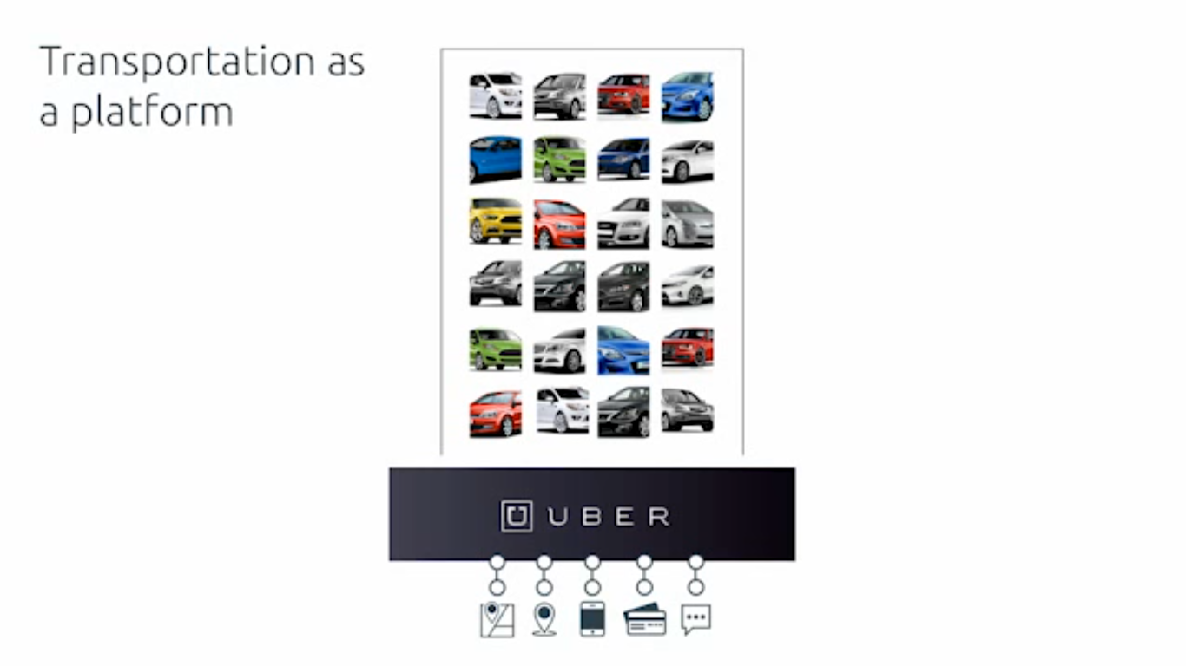
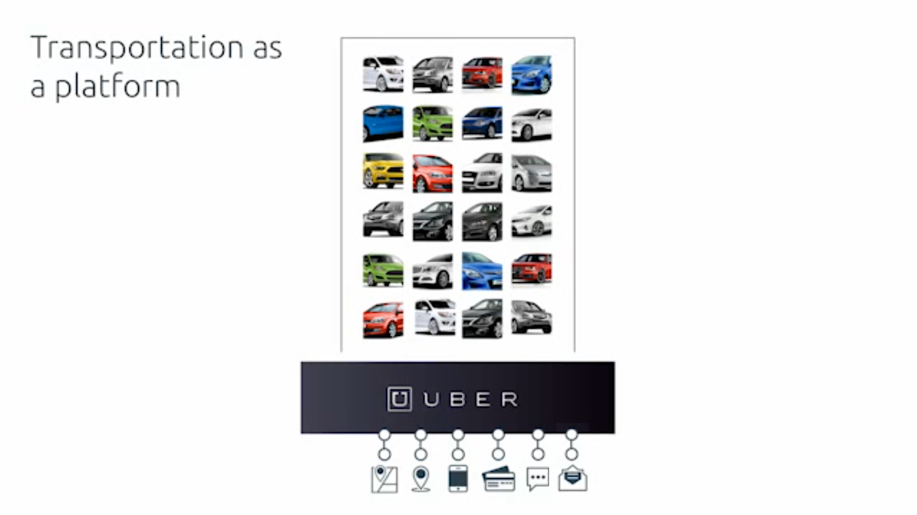

Slide 6


Slide 7
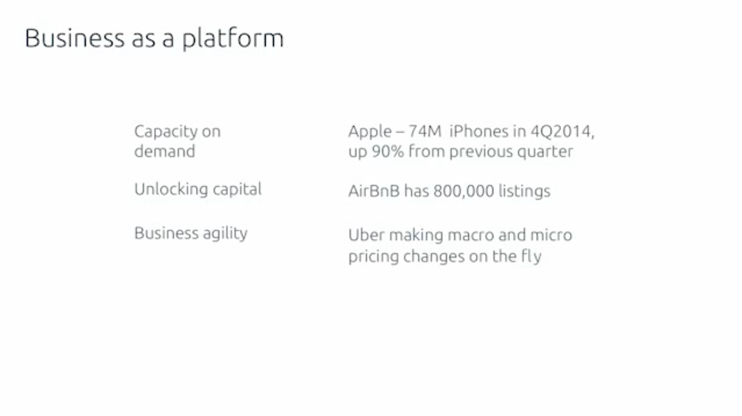

Slide 8
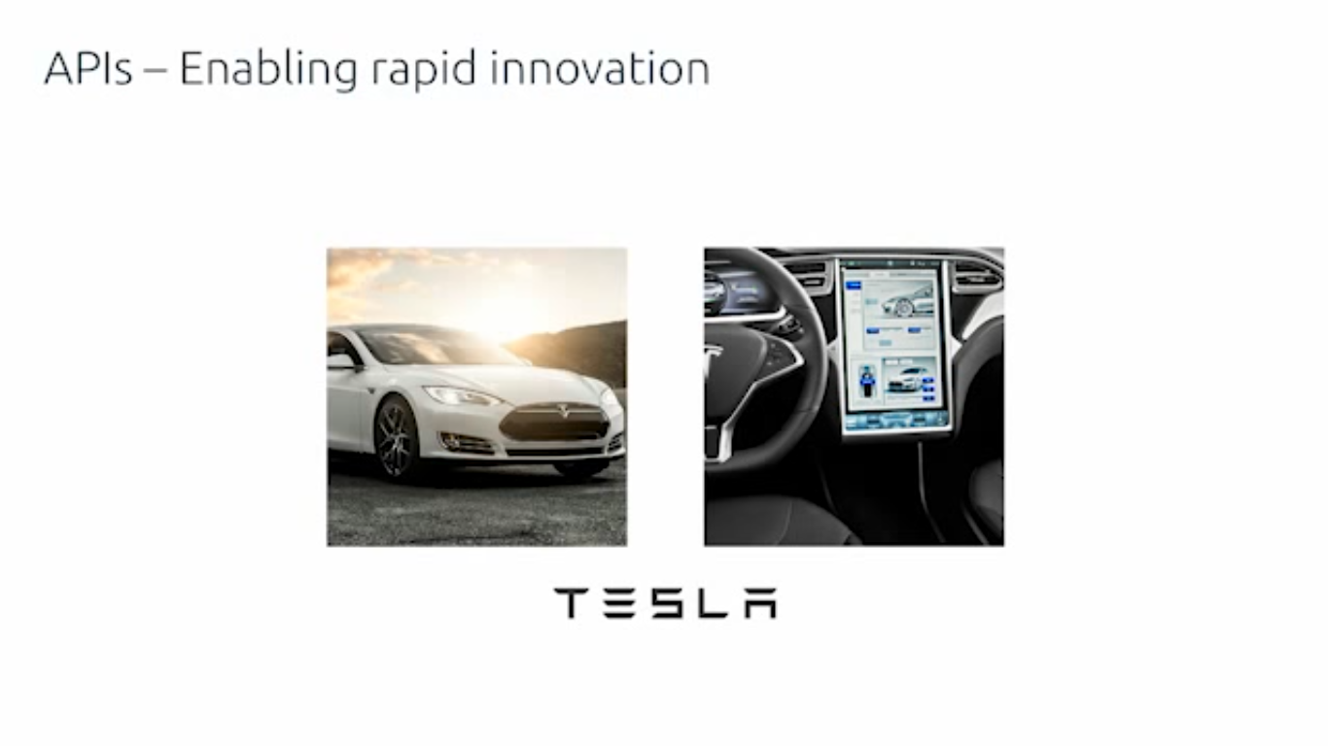

Slide 9
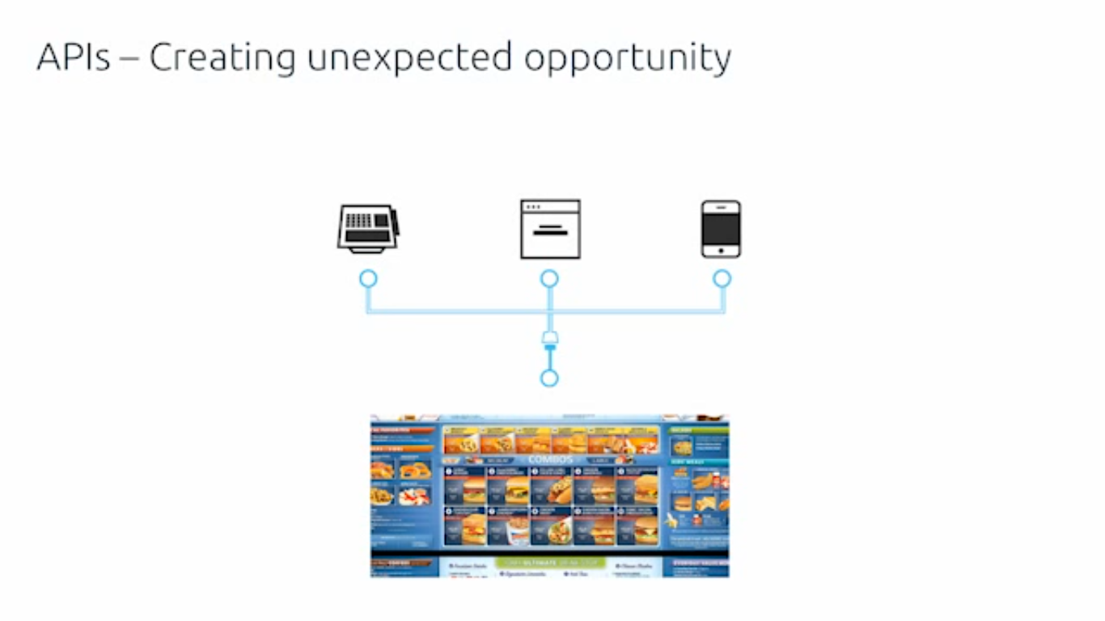

Slide 10

The company holds close to 25% market share of the OTA hotel booking segment
The company has been recognized as one of India's best travel portals.

Slide 11

redBus has been rated the most trusted brand in the online travel category and the 13th most trusted internet brand in the overall rankings as per the The Brand Trust Report, India Study 2015.^{[18]} It also won an award for being ‘The Most Trusted Brand’ by IBC InfoMedia in 2015. In March 2014 it won the 'Global Mobile Innovation in Travel Award’^{[19]}announced by Eyefortravel.
Redbus.in^{[14]} became a part of ibibo group via a 100% acquisition in June 2013.^{[15][16]} redBus is India’s Number One online bus ticketing platform, both on mobile and on desktop.

Slide 12

The company has partnered with over 40,000 restaurants.

Slide 13


Slide 14
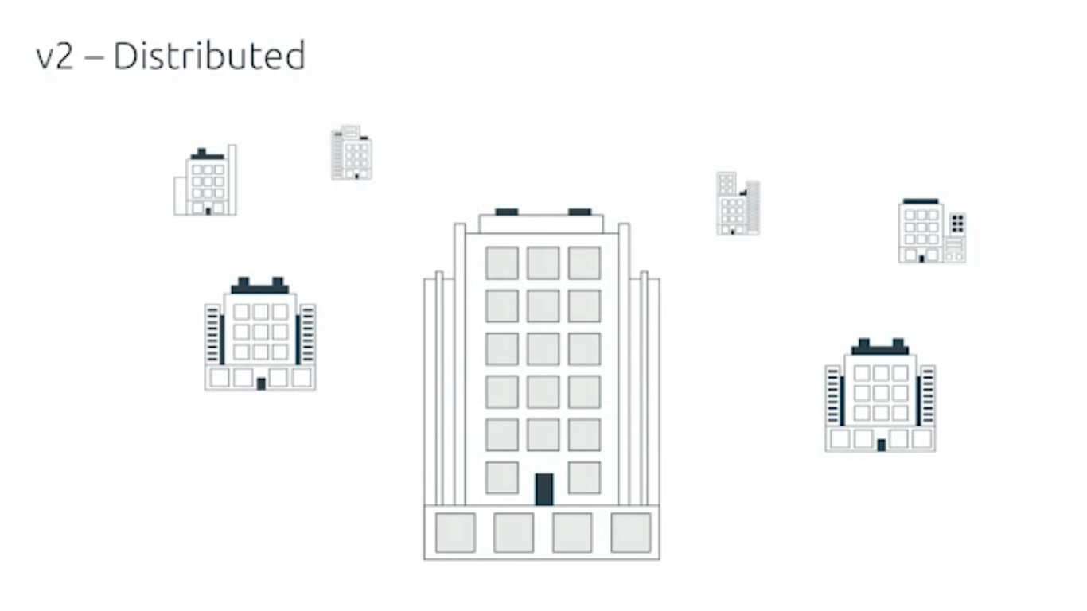

Slide 15
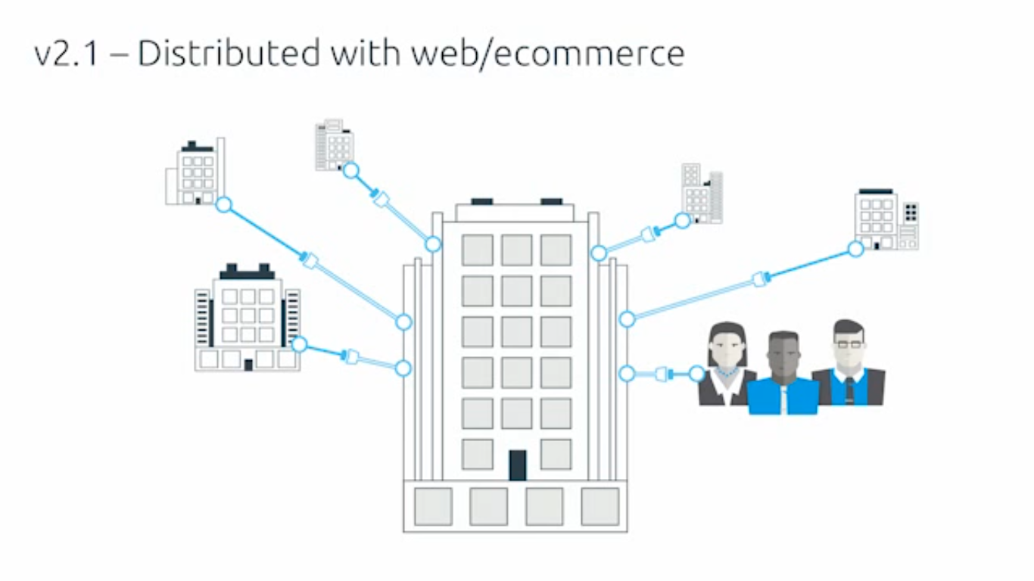

Slide 16
